Slide 1
What is Cluster Analysis?
Cluster: A collection of data objects
similar (or related) to one another within the same group
dissimilar (or unrelated) to the objects in other groups
Cluster analysis (or clustering, data segmentation, …)
Finding similarities between data according to the characteristics found in the data and grouping similar data objects into clusters
Unsupervised learning: no predefined classes (i.e., learning by observations vs. learning by examples: supervised)
Typical applications
As a stand-alone tool to get insight into data distribution
As a preprocessing step for other algorithms

Slide 2
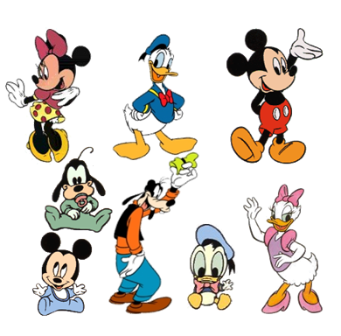
What is Cluster Analysis?

Slide 3
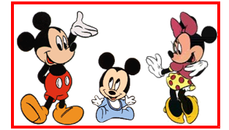
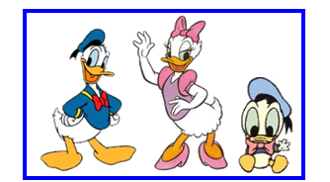
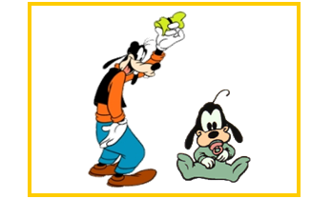
What is Cluster Analysis?
By Family

Slide 4
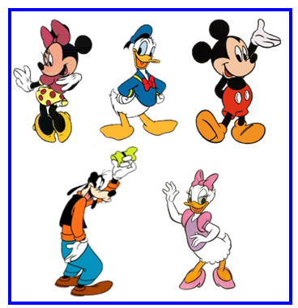
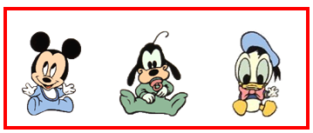
What is Cluster Analysis?
By Age

Slide 5
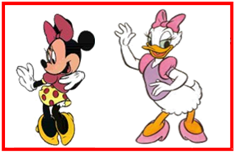
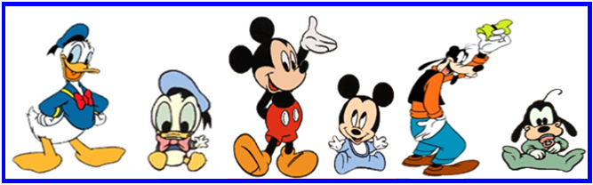
What is Cluster Analysis?
By Gender

Slide 6
Applications of Cluster Analysis
Data reduction
Summarization: Preprocessing for regression, PCA, classification, and association analysis
Compression: Image processing: vector quantization
Hypothesis generation and testing
Prediction based on groups
Cluster & find characteristics/patterns for each group
Finding K-nearest Neighbors
Localizing search to one or a small number of clusters
Outlier detection: Outliers are often viewed as those “far away” from any cluster

Slide 7
Clustering: Application Examples
Biology: taxonomy of living things: kingdom, phylum, class, order, family, genus and species
Information retrieval: document clustering
Land use: Identification of areas of similar land use in an earth observation database
Marketing: Help marketers discover distinct groups in their customer bases, and then use this knowledge to develop targeted marketing programs
City-planning: Identifying groups of houses according to their house type, value, and geographical location
Earth-quake studies: Observed earth quake epicenters should be clustered along continent faults
Climate: understanding earth climate, find patterns of atmospheric and ocean
Economic Science: market research

Slide 8
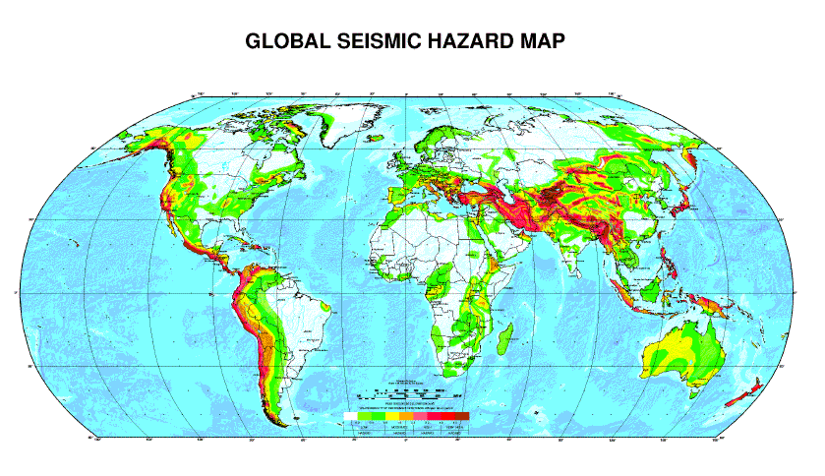
Earthquakes

Slide 9
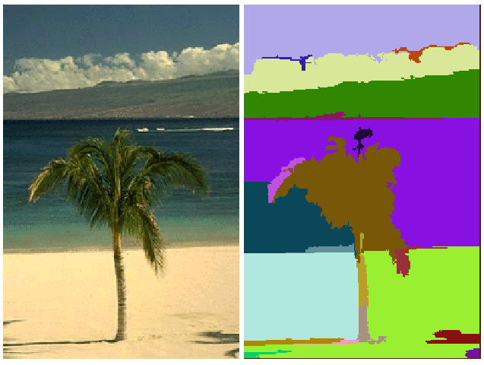
Image Segmentation

Slide 10
Basic Steps to Develop a Clustering Task
Feature selection
Select info concerning the task of interest
Minimal information redundancy
Proximity measure
Similarity of two feature vectors
Clustering criterion
Expressed via a cost function or some rules
Clustering algorithms
Choice of algorithms
Validation of the results
Validation test (also, clustering tendency test)
Interpretation of the results
Integration with applications

Slide 11
Quality: What Is Good Clustering?
A good clustering method will produce high quality clusters
high intra-class similarity: cohesive within clusters
low inter-class similarity: distinctive between clusters
The quality of a clustering method depends on
the similarity measure used by the method
its implementation, and
Its ability to discover some or all of the hidden patterns
Inter-cluster distances are maximized
Intra-cluster distances are minimized

Slide 12
Measure the Quality of Clustering
Dissimilarity/Similarity metric
Similarity is expressed in terms of a distance function, typically metric: d(i, j)
The definitions of distance functions are usually rather different for interval-scaled, boolean, categorical, ordinal ratio, and vector variables
Weights should be associated with different variables based on applications and data semantics
Quality of clustering:
There is usually a separate “quality” function that measures the “goodness” of a cluster.
It is hard to define “similar enough” or “good enough”
The answer is typically highly subjective

Slide 13
Considerations for Cluster Analysis
Partitioning criteria
Single level vs. hierarchical partitioning (often, multi-level hierarchical partitioning is desirable)
Separation of clusters
Exclusive (e.g., one customer belongs to only one region) vs. non-exclusive (e.g., one document may belong to more than one class)
Similarity measure
Distance-based (e.g., Euclidian, road network, vector) vs. connectivity-based (e.g., density or contiguity)
Clustering space
Full space (often when low dimensional) vs. subspaces (often in high-dimensional clustering)

Slide 14
Requirements and Challenges
Scalability
Clustering all the data instead of only on samples
Ability to deal with different types of attributes
Numerical, binary, categorical, ordinal, linked, and mixture of these
Constraint-based clustering
User may give inputs on constraints
Use domain knowledge to determine input parameters
Interpretability and usability
Others
Discovery of clusters with arbitrary shape
Ability to deal with noisy data
Incremental clustering and insensitivity to input order
High dimensionality

Slide 15
Major Clustering Approaches 1
Partitioning approach:
Construct various partitions and then evaluate them by some criterion, e.g., minimizing the sum of square errors
Typical methods: k-means, k-medoids, CLARANS
Hierarchical approach:
Create a hierarchical decomposition of the set of data (or objects) using some criterion
Typical methods: Diana, Agnes, BIRCH, CHAMELEON
Density-based approach:
Based on connectivity and density functions
Typical methods: DBSACN, OPTICS, DenClue
Grid-based approach:
based on a multiple-level granularity structure
Typical methods: STING, WaveCluster, CLIQUE

Slide 16
Major Clustering Approaches 2
Model-based:
A model is hypothesized for each of the clusters and tries to find the best fit of that model to each other
Typical methods: EM, SOM, COBWEB
Frequent pattern-based:
Based on the analysis of frequent patterns
Typical methods: p-Cluster
User-guided or constraint-based:
Clustering by considering user-specified or application-specific constraints
Typical methods: COD (obstacles), constrained clustering
Link-based clustering:
Objects are often linked together in various ways
Massive links can be used to cluster objects: SimRank, LinkClus

Slide 17
Partitioning Algorithms: Basic Concept
Partitioning method: Partitioning a database D of n objects into a set of k clusters, such that the sum of squared distances is minimized (where c_{i} is the centroid or medoid of cluster C_{i})
Given k, find a partition of k clusters that optimizes the chosen partitioning criterion
Global optimal: exhaustively enumerate all partitions
Heuristic methods: k-means and k-medoids algorithms
k-means (MacQueen’67, Lloyd’57/’82): Each cluster is represented by the center of the cluster
k-medoids or PAM (Partition around medoids) (Kaufman & Rousseeuw’87): Each cluster is represented by one of the objects in the cluster

Slide 18
The K-Means Clustering Method
Given k, the k-means algorithm is implemented in four steps:
Partition objects into k nonempty subsets
Compute seed points as the centroids of the clusters of the current partitioning (the centroid is the center, i.e., mean point, of the cluster)
Assign each object to the cluster with the nearest seed point
Go back to Step 2, stop when the assignment does not change

Slide 19
An Example of K-Means Clustering
K=2
Arbitrarily partition objects into k groups
Update the cluster centroids
The initial data set
Loop if needed
Reassign objects
Partition objects into k nonempty subsets
Repeat
Compute centroid (i.e., mean point) for each partition
Assign each object to the cluster of its nearest centroid
Until no change
Update the cluster centroids

Slide 20
k-Means Algorithms steps
Selecting the desired number of clusters k
Initialization k cluster centers (centroid) random
Place any data or object to the nearest cluster. The proximity of the two objects is determined based on the distance. The distance used in k-means algorithm is the Euclidean distance (d)
x = x1, x2,. , , , Xn and y = y1, y2,. , , , Yn n is the number of attributes (columns) between 2 records
Recalculate cluster centers with the current cluster membership. Cluster center is the average (mean) of all the data, or objects in a particular cluster
Assign each object again using the new cluster centers. If the cluster centers have not changed again, then the clustering process is completed. Or, go back to step 3 until the cluster centers do not change anymore (stable) or no significant decrease of the value of SSE (Sum of Squared Errors)

Slide 21
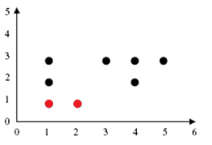
Exercise – Iteration 1
[STEP 1] Determine the number of clusters k = 2
[STEP 2] Determine the initial centroid random example of the data besides m1 = (1,1), m2 = (2,1)
[STEP 3] Place each object to the closest cluster centroid based on the closest value difference (distance).
 |  |  | m1 | m2
Instances | x | y | (1,1) | (2,1) | Cluster Membership
A | 1 | 3 | 2 | 3 | m1
B | 3 | 3 | 4 | 3 | m2
C | 4 | 3 | 5 | 4 | m2
D | 5 | 3 | 6 | 5 | m2
E | 1 | 2 | 1 | 2 | m1
F | 4 | 2 | 4 | 3 | m2
G | 1 | 1 | 0 | 1 | m1
H | 2 | 1 | 1 | 0 | m2

Slide 22
Exercise – Iteration 1
[STEP 4] The results obtained, members cluster1 = {A, E, G}, cluster2 = {B, C, D, F, H}. The SSE(Sum of Square Error) and MSE(Mean Square Error) values are:
SSE = [(1-1)²+(3-1)²]+ [(1-1)²+(2-1)²]+ [(1-1)²+(1-1)²]
+ [(3-2)²+(3-1)²]+ [(4-2)²+(3-1)²]+ [(5-2)²+(3-1)²]
+ [(4-2)²+(2-1)²]+ [(2-2)²+(1-1)²]
SSE = 4 + 1 + 0 + 5 + 8 + 13 + 5 + 0 = 36
MSE = 36/8 = 4.5
[STEP 5] The new centroid for
cluster1 = [(1 + 1 + 1)/3, (3 + 2 + 1)/3] = (1, 2) and
cluster2 = [(3 + 4 + 5 + 4 + 2)/5, (3 + 3 + 3 + 2 + 1)/5] = (3.6, 2.4)
Cluster1 Cluster 2
(1, 3) (3, 3)
(1, 2) (4, 3)
(1, 1) (5, 3)
(4, 2)
(2, 1)
-------- --------
(3/3, 6/3) (18/5, 12/5)
(1, 2) (3.6, 2.4)

Slide 23
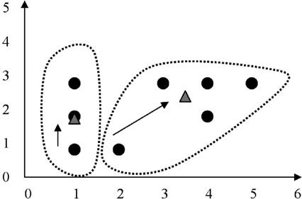
Exercise – Iteration 2
[STEP 3] Place each object to the closest cluster centroid based on the closest value difference (distance).
 |  |  | m1 | m2
Instances | x | y | (1,2) | (3.6,2.4) | Cluster Membership
A | 1 | 3 | 1 | 3.2 | m1
B | 3 | 3 | 3 | 1.2 | m2
C | 4 | 3 | 4 | 1 | m2
D | 5 | 3 | 5 | 2 | m2
E | 1 | 2 | 0 | 3 | m1
F | 4 | 2 | 3 | 0.8 | m2
G | 1 | 1 | 1 | 4 | m1
H | 2 | 1 | 2 | 3 | m1

Slide 24
Exercise – Iteration 2
[STEP 4] The results obtained, members cluster1 = {A, E, G, H}, cluster2 = {B, C, D, F}. The new SSE and MSE values are:
SSE = [(1-1)²+(3-2)²]+ [(1-1)²+(2-2)²]+ [(1-1)²+(1-2)²] + [(2-1)²+(1-2)²]
+ [(3-3.6)²+(3-2.4)²]+ [(4-3.6)²+(3-2.4)²]+ [(5-3.6)²+(3-2.4)²]
+ [(4-3.6)²+(2-2.4)²]
SSE = 1 + 0 + 1 + 2 + 0.72 + 0.52 + 2.32 + 0.32 = 7.88
MSE = 7.88/8 = 0.985
[STEP 5] The new centroid for
cluster1 = [(1 + 1 + 1+2)/4, (3 + 2 + 1+1)/4] = (1.25,1.75) and
cluster2 = [(3 + 4 + 5 + 4 )/4, (3 + 3 + 3 + 2 )/4] = (4, 2.75)

Slide 25
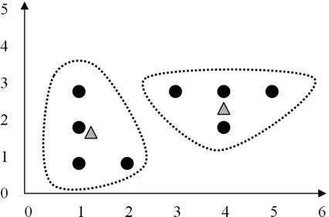
Exercise – Iteration 3
[STEP 3] Place each object to the closest cluster centroid based on the closest value difference (distance).
 |  |  | m1 | m2
Instances | x | y | (1.25,1.75) | (4, 2.75) | Cluster Membership
A | 1 | 3 | 1.5 | 3.25 | m1
B | 3 | 3 | 3 | 1.25 | m2
C | 4 | 3 | 4 | 0.25 | m2
D | 5 | 3 | 5 | 1.25 | m2
E | 1 | 2 | 0.5 | 3.75 | m1
F | 4 | 2 | 3 | 0.75 | m2
G | 1 | 1 | 1 | 4.75 | m1
H | 2 | 1 | 1.5 | 3.75 | m1

Slide 26
Exercise – Iteration 3
[STEP 4] The results obtained, members cluster1 = {A, E, G, H}, cluster2 = {B, C, D, F }. The new SSE and MSE values are:
SSE = [(1-1.25)²+(3-1.75)²]+ [(1-1.25)²+(2-1.75)²]+ [(1-1.25)²+(1-1.75)²] + [(2-1.25)²+(1-1.75)²] + [(3-4)²+(3-2.75)²]+ [(4-4)²+(3-2.75)²]+ [(5-4)²+(3-2.75)²] + [(4-4)²+(2-2.75)²]
SSE = 1.625 + 0.125 + 0.625 + 0.125 + 1.0625 + 0.0625 + 1.0625 + 0.5625 = 7.88
MSE = 6.25/8 = 0.78125
[STEP 5] The new centroid for
cluster1 = [(1 + 1 + 1+2)/4, (3 + 2 + 1+1)/4] = (1.25,1.75) and
cluster2 = [(3 + 4 + 5 + 4 )/4, (3 + 3 + 3 + 2 )/4] = (4, 2.75)

Slide 27
Final Result
Can be seen in the table. No change of members again on each cluster
The final results are:
cluster1 = {A, E, G, H}, and
cluster2 = {B, C, D, F}
With SSE value = 6.25 and MSE value = 0.78125
the number of iterations 3

Slide 28
Comments on the K-Means Method
Strength:
Efficient: O(tkn), where n is # objects, k is # clusters, and t is # iterations. Normally, k, t << n.
Comparing: PAM: O(k(n-k)² ), CLARA: O(ks² + k(n-k))
Comment: Often terminates at a local optimal
Weakness
Applicable only to objects in a continuous n-dimensional space
Using the k-modes method for categorical data
In comparison, k-medoids can be applied to a wide range of data
Need to specify k, the number of clusters, in advance (there are ways to automatically determine the best k (see Hastie et al., 2009)
Sensitive to noisy data and outliers
Not suitable to discover clusters with non-convex shapes

Slide 29
Variations of the K-Means Method
Most of the variants of the k-means which differ in
Selection of the initial k means
Dissimilarity calculations
Strategies to calculate cluster means
Handling categorical data: k-modes
Replacing means of clusters with modes
Using new dissimilarity measures to deal with categorical objects
Using a frequency-based method to update modes of clusters
A mixture of categorical and numerical data: k-prototype method

Slide 30
What Is the Problem of the K-Means Method?
The k-means algorithm is sensitive to outliers!
Since an object with an extremely large value may substantially distort the distribution of the data
K-Medoids:
Instead of taking the mean value of the object in a cluster as a reference point, medoids can be used, which is the most centrally located object in a cluster
10
10
9
9
8
8
7
7
6
6
5
5
4
4
3
3
2
2
1
1
0
0
1
2
3
4
5
6
7
8
9
10
0
0
1
2
3
4
5
6
7
8
9
10

